Slide 1
Agile Introduction
Manifesto & Principles

Slide 2
Agile
Agile is an iterative approach to project management and software development that helps teams deliver value to their customers faster and with fewer headaches. ... Requirements, plans, and results are evaluated continuously so teams have a natural mechanism for responding to change quickly.
In software development, agile practices approach discovering requirements and developing solutions through the collaborative effort of self-organizing and cross-functional teams and their customer/end user.
Agile software development refers to a group of software development methodologies based on iterative development, where requirements and solutions evolve through collaboration between self-organizing cross-functional teams. ... Read more about the Agile Manifesto.

Slide 3

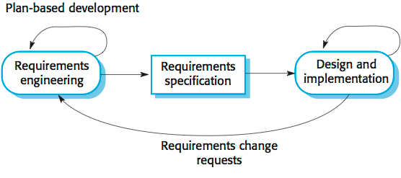
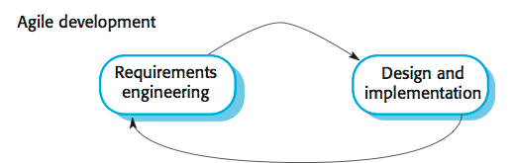
Software Development Processes Plan-driven and agile processes
Plan-driven processes are processes where all of the process activities are planned in advance and progress is measured against this plan.
In agile processes, planning is incremental and it is easier to change
the process to reflect changing customer requirements.
In practice, most practical processes include elements of both plan-driven and agile approaches.
There are no right or wrong software processes.

Slide 4
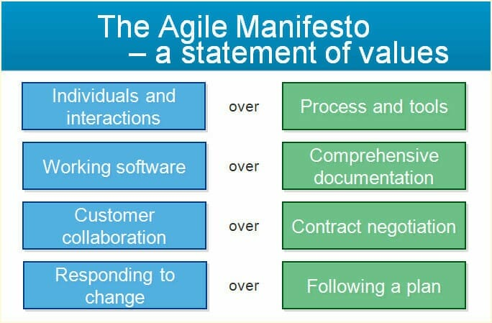

Slide 5
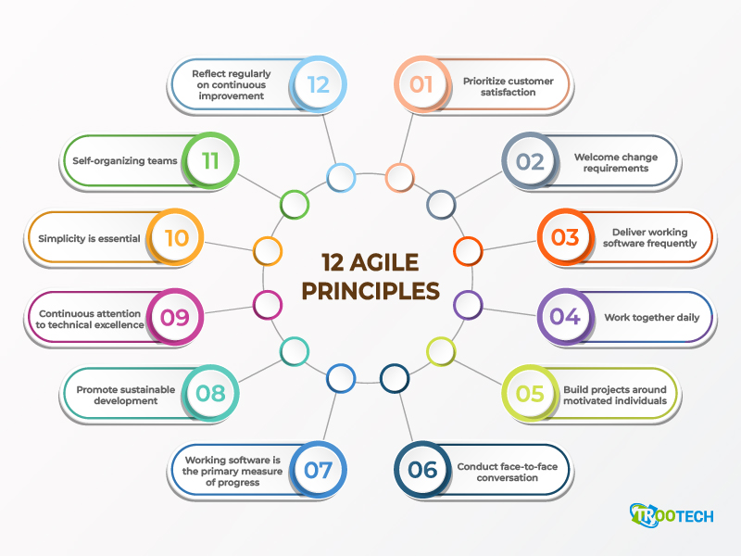

Slide 6
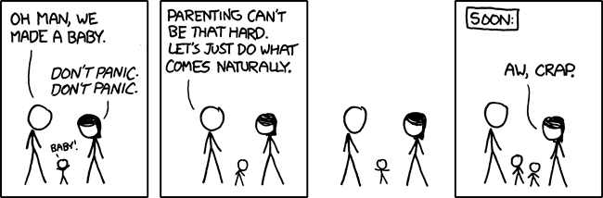
agile – “doing what come naturally”
Not always the best idea, but let’s give it a try

Slide 7
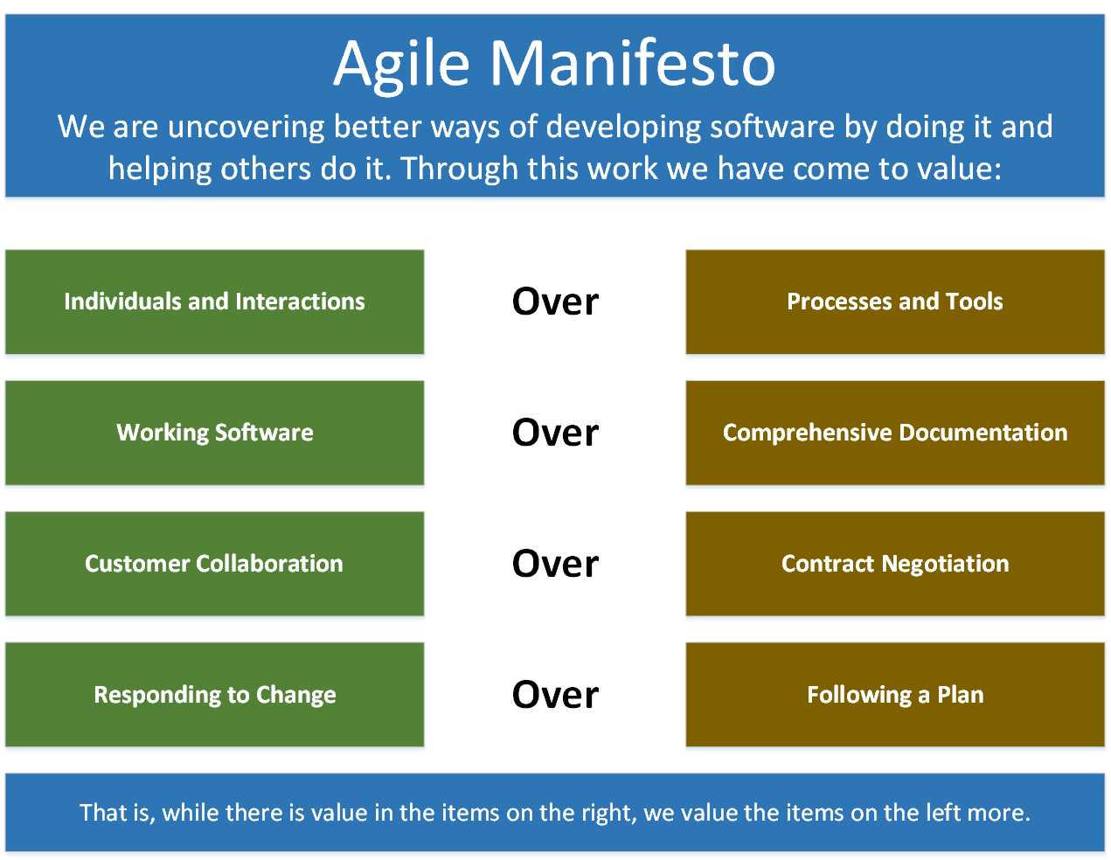
Agile Manifesto
The Agile Manifesto is based on 12 principles
Customer satisfaction by rapid delivery of useful software
Welcome changing requirements, even late in development
Working software is delivered frequently (weeks rather than months)
Close, daily cooperation between business people and developers
Projects are built around motivated individuals, who should be trusted
Face-to-face conversation is the best form of communication (co-location)
Working software is the principal measure of progress
Sustainable development, able to maintain a constant pace
Continuous attention to technical excellence and good design
Simplicity—the art of maximizing the amount of work not done—is essential
Self-organizing teams
Regular adaptation to changing circumstance

